Slide 1


BlackRock Investment Analysis
Weekly status report 2

Slide 2
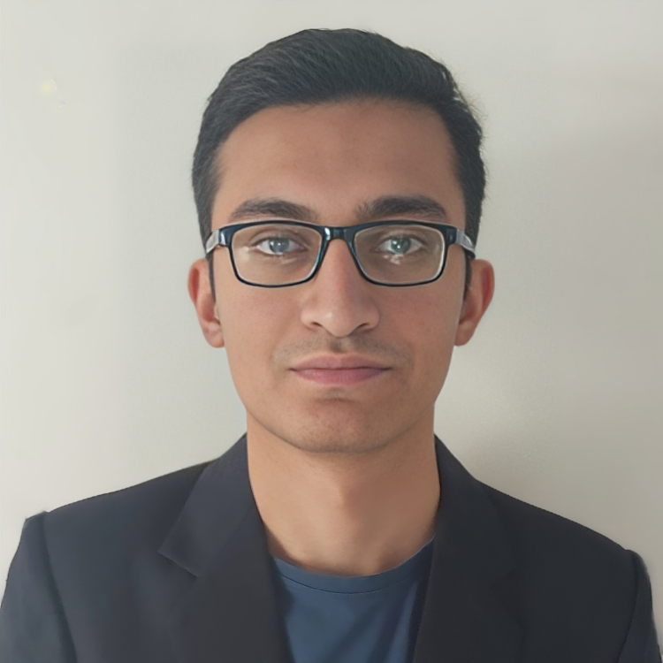
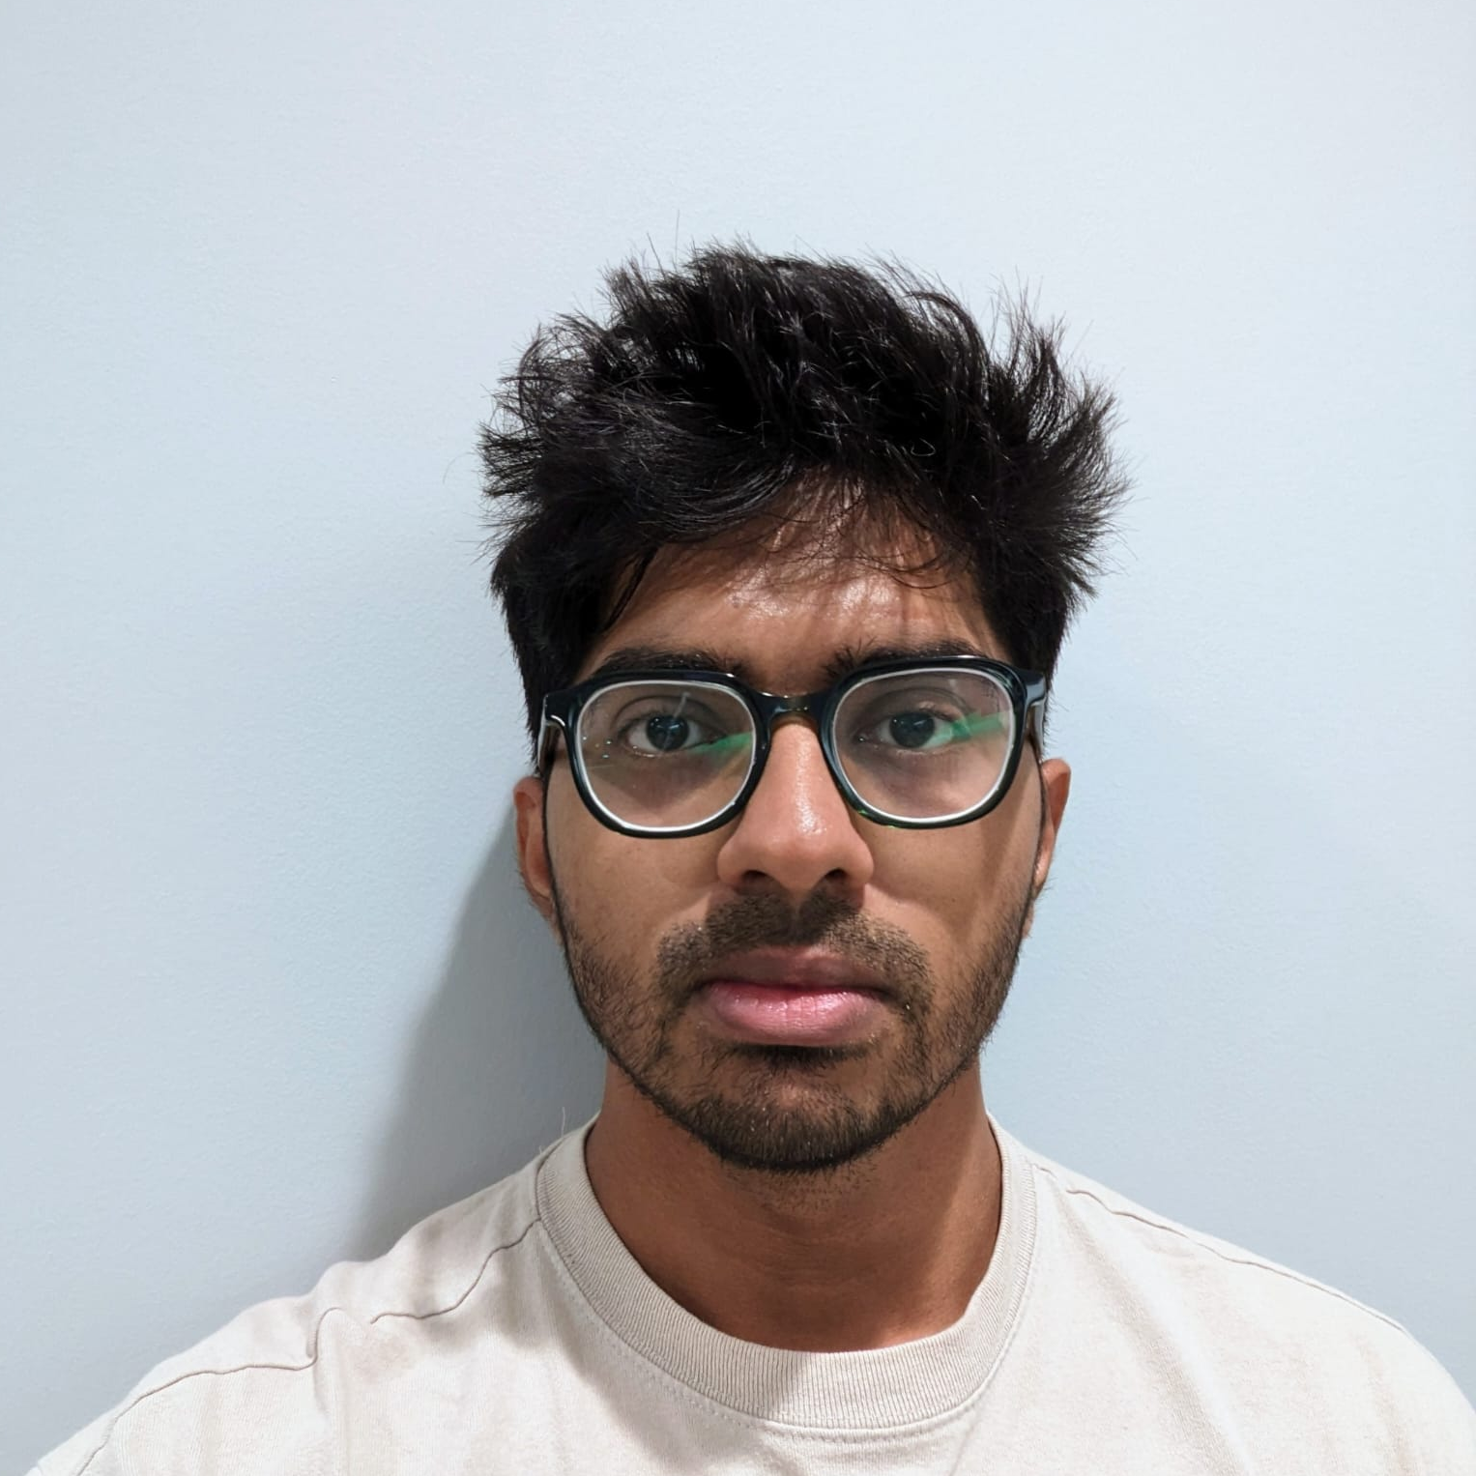

Team Members
Aryan Radadiya
Developer
Joyson Gonsalves
Team Lead
Sumit Kumar Pandey
Data Analyst

Slide 3
Date of Report: 23rd January 2024
Date of Last Report: 16th January 2024
Prepared By: Group 7
Project Status: On Track

Slide 4

Activities Since Last Report
Issues or Challenges encountered this week:
Importing data directly from website.
Adjusting the header of the data to align in proper format.
What was done to overcome them:
We downloaded whole data in our local machine and then imported it to Jupiter notebook.
We split the data in two sections and then adjusted the headers accordingly and combined the data.

Slide 5
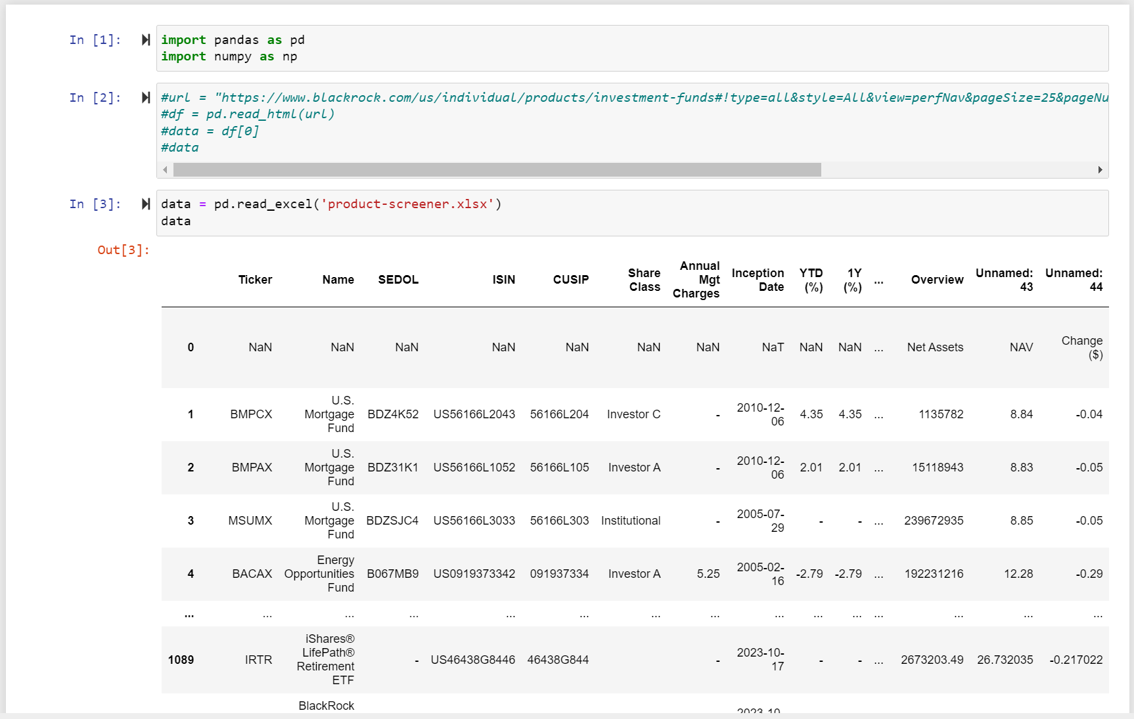
Screenshots of Activities

Slide 6
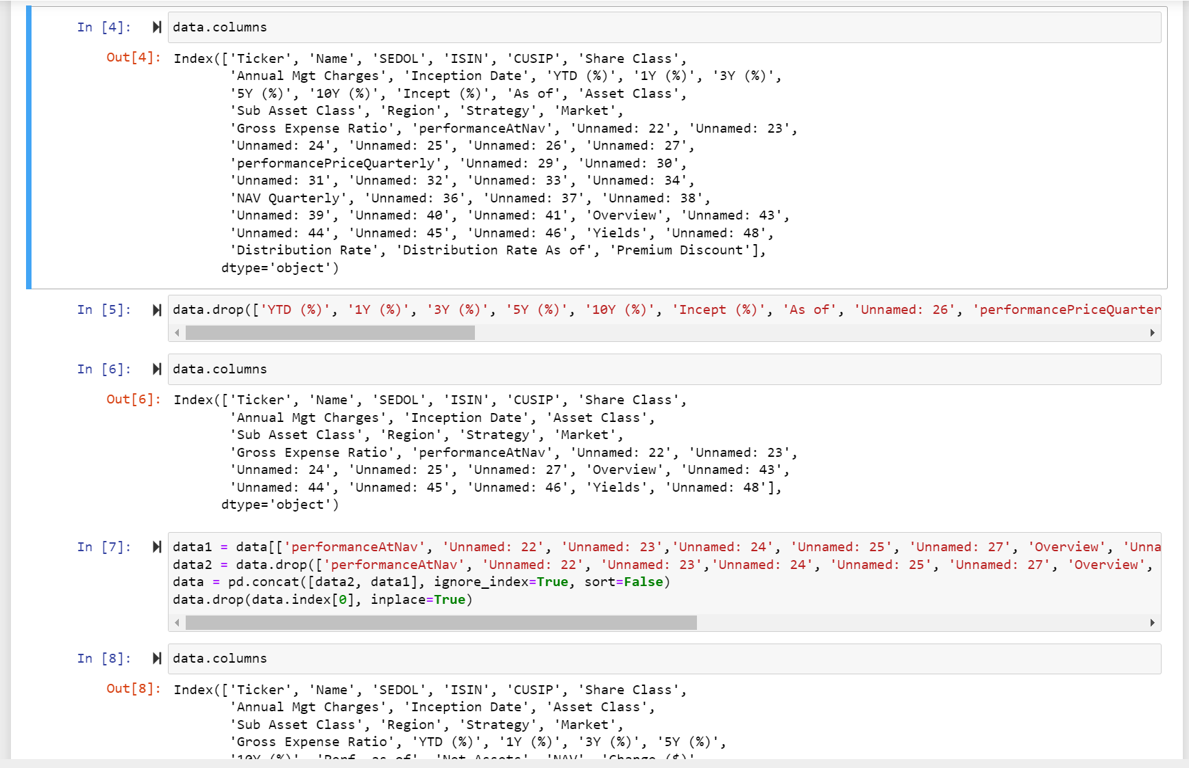
Screenshots of Activities

Slide 7
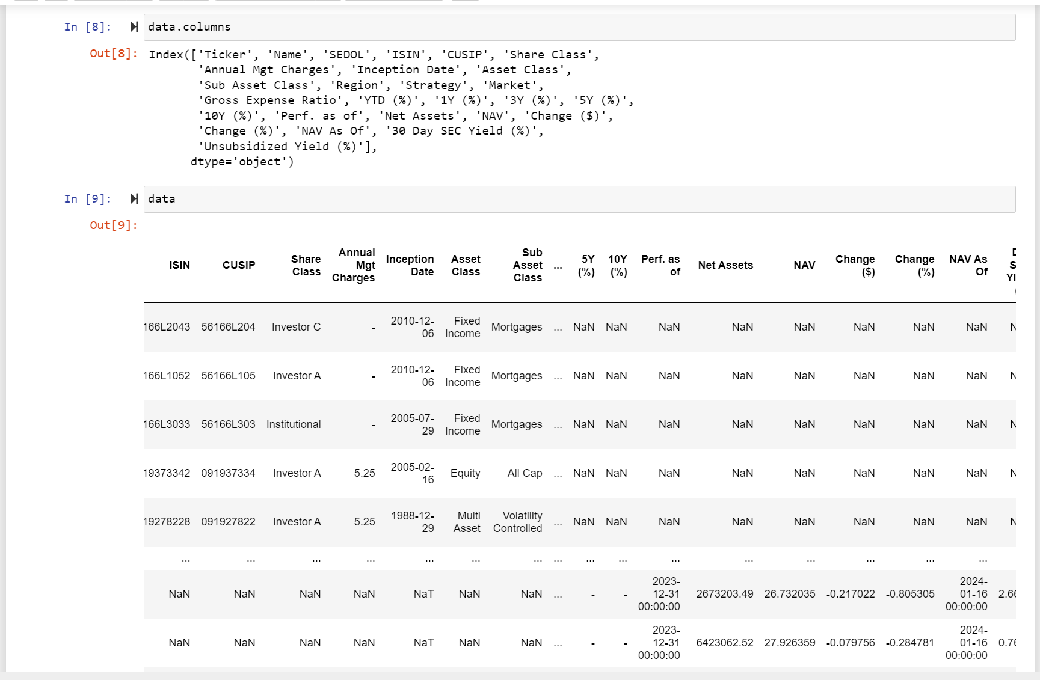
Screenshots of Activities

Slide 8



Communication
We had a phone conversation regarding the project progress and how we are going to proceed

Slide 9

Activities to be completed before next week
Completing the share point Site.
Solving the issues occurred during the cleaning process.
Completing the cleaning process and start data processing.

Slide 10


Thank You Any Questions?

